Slide 1


ISE-200-Financial Methods For Engineers Evaluating Residential Investment Strategies
Salma : 016764644
Anusha : 016785639
Monica : 016764358
Shreya : 016707236

Slide 2
Agenda
Introduction
Problem Identification
Challenges
Methods
Results
Analysis
Discussion
Conclusion
Reference

Slide 3

Introduction
In San Jose and Sunnyvale's competitive real estate markets, informed decisions on property acquisition are vital.
A comprehensive overview examines four acquisition methods for 1 BHK flats, encompassing full payment and leasing.
By analyzing key financial metrics such as NPV and EUAW, stakeholders gain valuable insights into navigating these high-demand Silicon Valley cities effectively.
Ultimately, informed decision-making benefits both investors and potential residents.

Slide 4

Problem Identification
In San Jose and Sunnyvale's real estate scene, individuals and stakeholders strive to determine the best approach for acquiring one-bedroom apartments. With options ranging from leasing to full upfront payment, evaluating the economic implications is crucial. Our goal is to provide clarity by examining key financial metrics like EUAW and NPV. This analysis aims to empower informed decision-making in highly competitive housing markets.
What factors guide optimal one-bedroom apartment purchases in San Jose/Sunnyvale?

Slide 5

Challenges
Financial Complexity: Understanding and comparing payment options like full payment, bank loans, and leases requires expertise due to differing costs, cash flows, and NPVs.
Maintenance Fees and Other Costs: Recurring maintenance fees significantly impact the overall cost of ownership over time, necessitating careful evaluation for decision-making.
Salvage Value and Depreciation: Considering salvage value, depreciation, and property fluctuations is crucial for long-term investment and exit planning in real estate.
Interest Rates and Loan Terms: Interest rates, down payments, and repayment plans impact affordability and financing costs, with changes affecting total expenses and option viability.
Market Volatility and Inflation: Assumptions on inflation, appraisal rates, and depreciation introduce expense uncertainty, impacting payment option viability amid market changes.
Comparing Lease vs. Ownership: Evaluation entails comparing lease options with ownership choices, considering factors like long-term equity building, flexibility, and financial stability.

Slide 6

Methods
Data Collection: Gathering property prices, fees, loan terms, and salvage value estimates.
Net Present Value Calculation: Computing NPV by discounting cash flows and deducting costs.
Depreciation and Salvage Value Calculation: Predicting property value trajectory and selling value.
Loan Repayment Analysis: Examining loan amount, down payment, interest rate, and repayment amounts.
Comparison of Cash Flows and Costs: Comparing inflows and outflows across payment options.
Sensitivity Analysis and Financial Assumptions: Assessing financial assumptions through sensitivity analysis.

Slide 7

Results
Higher Salvage Value: Sunnyvale offers a higher salvage value, enhancing long-term asset retention.
Better EUAW: Sunnyvale's higher EUAW suggests superior long-term investment returns.
Favorable NPV in Specific Cases: Sunnyvale displays a more favorable NPV in cases like Bank Loan Option 1 and Buyout through third-party dealer Option 1.
More Expensive Monthly Payments: Despite higher monthly payments in Sunnyvale, justified by higher salvage values and EUAW.
Consistent Negative NPV for Leases: Leasing options without buyout show consistent negative NPV, indicating less favorability.

Slide 8
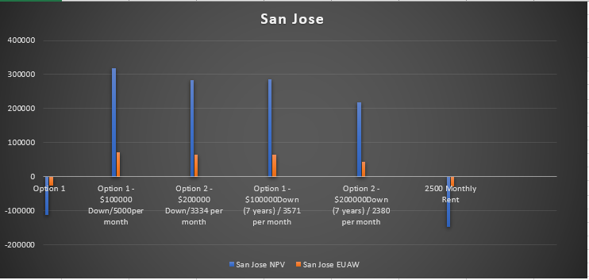
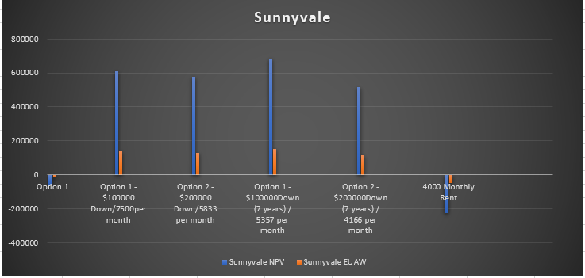
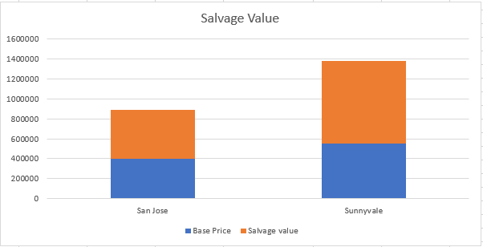
Analysis

Slide 9

Discussion
Examination of payment methods for a one-bedroom apartment provides key decision insights.
NPV computation over seven years considers one-time expenses, maintenance, loan repayments, and salvage value.
The viability and profitability of leases, bank loans, and full payments are assessed using NPV.
Consideration of salvage value and depreciation influences resale strategies.
Analysis of loan payback informs affordability and financing costs.

Slide 10

Conclusion
Valuable insights into the economic dynamics of acquiring one-bedroom apartments in San Jose and Sunnyvale are provided. Stakeholders gain clarity on viable pathways to property ownership through meticulous analysis. Crucial considerations include maintenance fees, salvage value, and market volatility, empowering individuals and investors to navigate real estate markets confidently for successful acquisitions.

Slide 11
Reference
Ignoffo, M. J. (1991). Sunnyvale: From the" city of Destiny" to the" heart of the Silicon Valley". San Jose State University.
Baar, K., Burns, P., & Flaming, D. (2016). San José ARO Study: A Study of the Apartment Rent Ordinance of the City of San José. Available at SSRN 3380034.
Foss, M. (2004). Inclusionary housing requirements in California: examining the economic impact on three cases (Doctoral dissertation, Massachusetts Institute of Technology).
Meese, R., & Wallace, N. (1994). Testing the present value relation for housing prices: Should I leave my house in San Francisco?. Journal of urban Economics, 35(3), 245-266.
Shami, M. (2006). A comprehensive review of building deconstruction and salvage: deconstruction benefits and hurdles. International journal of environmental technology and management, 6(3-4), 236-291.
Mathur, S., & Parker, A. (2007). Housing Silicon Valley: A 20 Year Plan to End the Affordable Housing Crisis.

Slide 12



